Slide 1
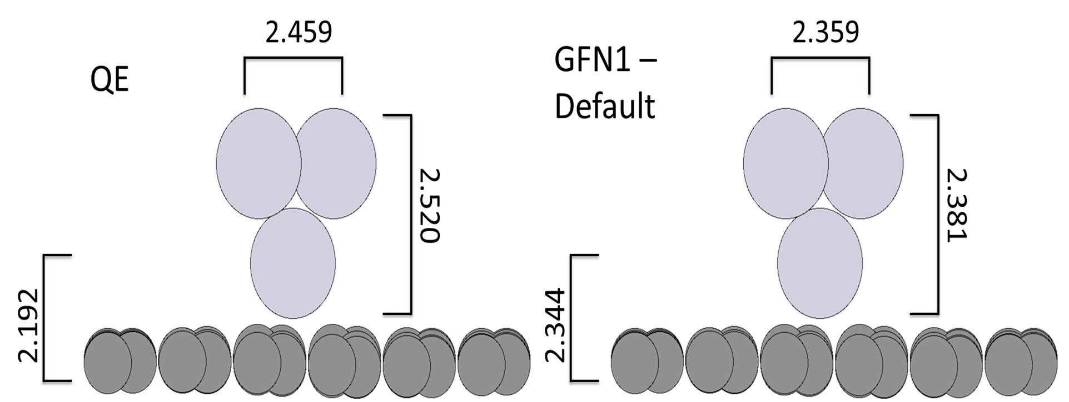
Ryan Wang – Nov. 9, 2022

Slide 2

Brianna Haase – Nov. 9, 2022

Slide 3
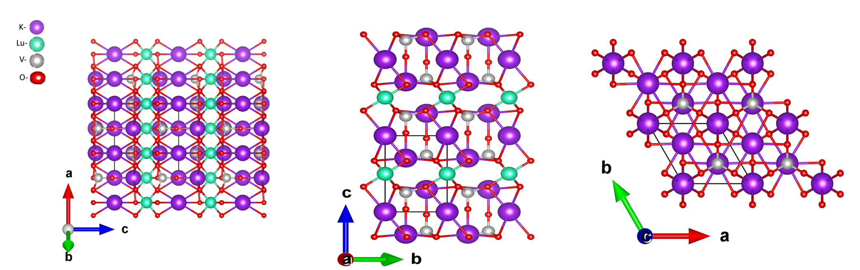
Devin Craig – Nov. 9, 2022

Slide 4
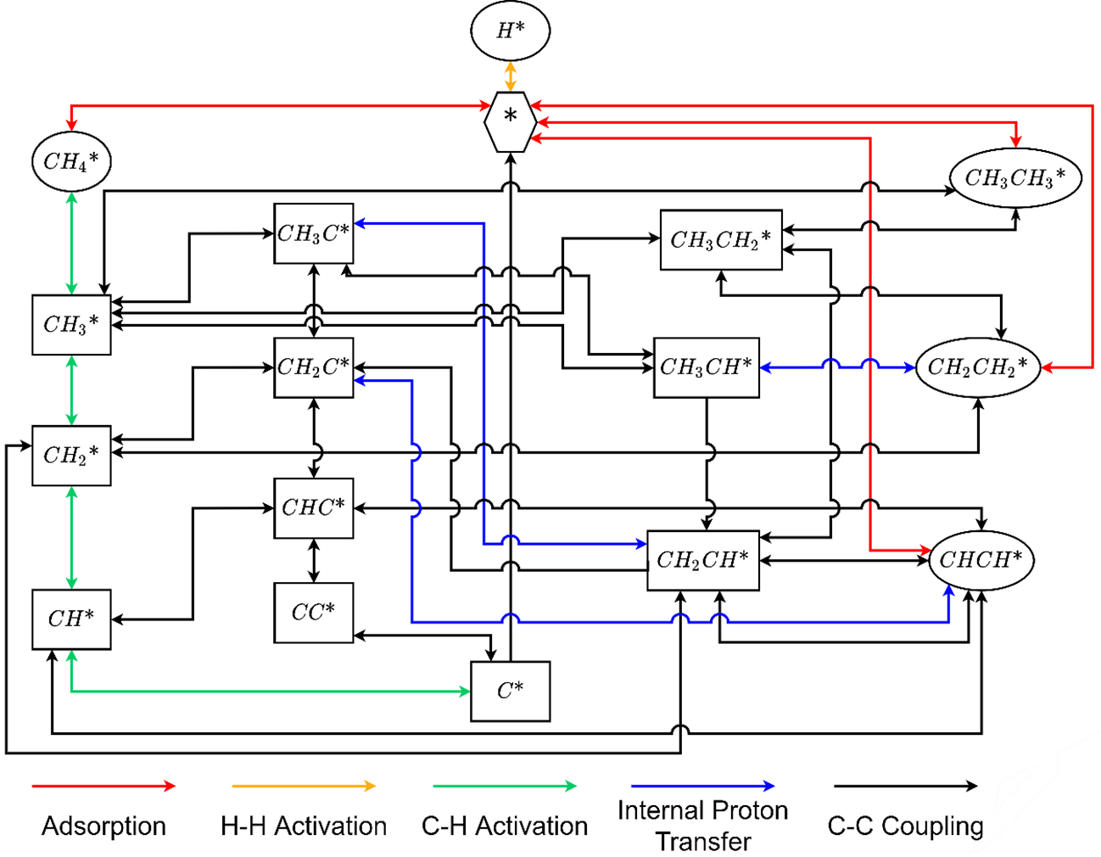
George Barton – Nov. 9, 2022

Slide 5
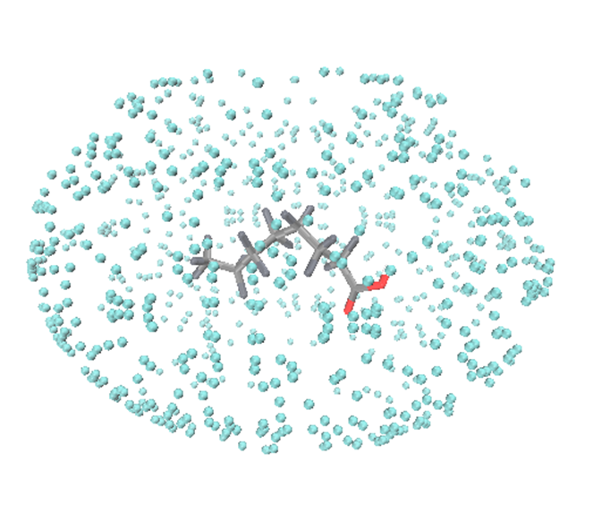
Elizabeth Serna-Sanchez – Nov. 9, 2022

